Slide 1
Welcome to Thresholds
A Volunteer Outreach Program
Supporting
Chester County Prison and Youth Center
501 South Wawaset Road
West Chester, PA 19382
Notes:
Leave up/open as volunteers arrive

Slide 2
Thresholds Volunteer Training
March 2019
Notes:
Welcome everyone to Thresholds Volunteer Training….Thank everyone for giving up their Saturday to learn the Threshold’s Program and become a volunteer.

Slide 3
Agenda
Registration
Introductions/Structured Conversation
Overview of Thresholds
6 Step Overview
Prison Information/Prison Clearance Forms
Micro/Macro Overview
  Distribute Vol. Teacher Guide & Student Manual
Outline/Detail/Demo – 6 Steps Decision Model
Going to Prison/Prison Guidelines
Open Issues
Closing Ritual & Critique of the day
Notes:
We have a full agenda and will be going from 9-4. We have a break in the morning and one in the afternoon and we also have time for lunch; so if you would silence your phones and put them away and check messages at breaks and lunch that is great. If you need to take an emergency call or text please go in the hallway so we can continue on. Let everyone know where the bathrooms are!
Restroom Locations?
Any other housekeeping items?

Slide 4
Structured Conversation
My name is …
I am here because…
Notes:
Jump right in…Structured conversations are used in Thresholds to start all of our meetings and classes. This is a way to “warm everyone up” and they are not a time to give a short story for the answer. A quick sentence is what we are looking for.
This also provides additional information about the volunteers.
List questions on flip chart.

Slide 5
Facilitators Today
Training will be facilitated by 3 people:
Jarrett Jackson | Pres. Mid Atlantic Thresholds VP Chester County Thresholds IT consultant
Gerry Stein | Prison - Men’s Macro Teacher Chester County Thresholds President retired hr manager
5
Notes:
4 facilitators today to train you and we all have diversified business and thresholds backgrounds so if any questions come up we have a good group to be able to answer most questions. There are other threshold volunteers here in the back of the room and urge everyone to chat with them at breaks and lunch time.

Slide 6
Objectives
Present info needed to be a Thresholds Volunteer Teacher
  Learn 6-step Decision Model
  Learn about Communication tools & resources in the teacher Manual
  Review the Student ‘Guide to Decision Making’
  Understand the process and rules about going to the Prison
Answer questions about the Thresholds org, program content , & the role of a Thresholds volunteer
Ensure Volunteers feel confident in their role
Provide an opportunity to meet & begin networking with other Volunteers
Notes:
4 Objectives for the day—for you to understand the program and tools; which includes prison process and rules…so if you are feeling a bit uneasy about that know that it will be addressed, second to answer any questions you have, 3 to have you leaving here confident in your role and finally to network….great way to meet new people.

Slide 7
Agenda
Registration
Introductions/Structured Conversation
Overview of Thresholds
6 Step Overview
Prison Information/Prison Clearance Forms
Micro/Macro Overview
  Distribute Vol. Teacher Guide & Student Manual
Outline/Detail/Demo – 6 Steps Decision Model
Going to Prison/Prison Guidelines
Open Issues
Closing Ritual & Critique of the day
Notes:
This section of the agenda deals with an Overview of Thresholds so you have an understanding of what the organization is, does, and stands for.

Slide 8
Who is Thresholds?
Thresholds is a non-profit organization since 1980 that teaches decision-making skills to interested inmates who are in minimum security.
Our Goal… is that inmate-students will cross-over a “threshold” to a new beginning in their lives as they start to make decisions that will serve them in a more positive way.
Diverse group of community volunteers are the backbone of this program’s success.
Notes:
Thresholds is made up of a group of volunteers who care about others and want to make a difference in their community. Thresholds volunteers are positive people who encourage our clients to work toward a better life by using the Thresholds Steps in Decision Making.

Slide 9
What is Thresholds
Program Background
Designed by former inmate Milton Burglass, imprisoned for embezzlement, who believed the biggest challenge for those in prison was their ability to make sound and informed decisions
He developed a very basic process designed to slow down the decision making process to evaluate options… to think before acting
Six Steps
Define the situation
Set the goal
Develop the possibilities to reach the goal
Evaluate the possibilities, to ID those most likely to accomplish the goal
Make the decision
Implement the decision, [strategies, tactics and timeline]
Notes:
Milton “Mickey” Burglaas attended Harvard University after he was released and earned his doctorate and formalized his decision-making process into the highly successful program known as Tresholds. He founded his own organization called Correctional Solutions, Inc. and helped to establish the first Thresholds in Bucks County, PA in 1972. Mickey Burlgass also earned an MD degree!
These six steps are the basis for the Threholds Decision Making Process and what we teach in our course. You will learn about them today.

Slide 10

Thresholds Beliefs
The Thresholds philosophy is based on:
The Principle of Self-Determination
  Everyone is responsible for his/her own acts.
The Ethic of Autonomy
  Everyone has the freedom to be who ever he/she decides to be.
The Principle of Community Responsibility
  Everyone in a community is responsible for the care of all others in the community.
The Ethic of Individual Commitment
  Everyone should commit to Thresholds as an end it itself, not to promote one’s own agenda.
We use symbols and icons to remember understand key concepts
The Thresholds symbol shows the past cutoff - by the vertical ‘Threshold line’, which is an open door to the future
The world is composed of family, friends, neighbors, & events – accepted as is
Self is who I am, entitled to be accepted
world
past
future
self
10
Notes:
This is the belief system of Thresholds.
Follow explanation.
Symbols and rituals are key to remembering the Thresholds steps. Take time to talk about the explanation of the Thresholds symbol.
Diagram in the Rectangle box is inaccurate – combined several steps.

Slide 11
Who We Are & Who We Teach
Brings together caring members of the community
with those who are ready to improve their decision making skills
Participants [Clients]
Adult Men
Adult Women
Youth
All participate on a volunteer basis
Each are interviewed to ensure a good fit
Minimum security only
Active Volunteers
Teachers, homemakers, business people, social workers, college professors, etc…
Includes actively employed as well as retired folks
Age Ranging from 20’s to 80s
Thresholds is the largest, continuous running skills and self-help course at the Chester County Prison – supported by Prison Administration on all levels
Notes:
Thresholds is a diverse group of people wanting to help others.
We are well-respected by the prison and the court system. By completing today’s training and passing the clearance, you will become am active volunteer qualified to go into the prison as a Micro teacher.
Prospective participants’ names are given to the Cycle Coordinator from the prison through the Counselors. All participants are voluntary. No one is required to complete Thresholds.

Slide 12
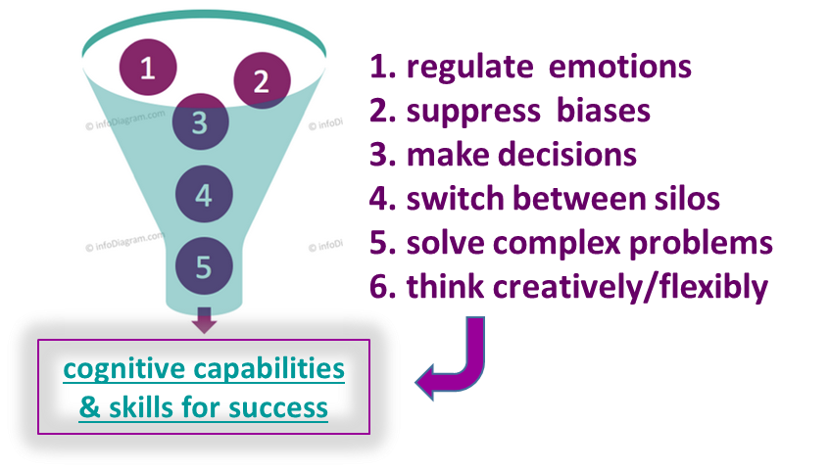
Why We Teach It
Learn & Use the Decision Process |  | Improve Decision Making Abilities |  | Growth: Self Reliance Personal Autonomy Self - Determination |  | Greater: Control Self Image Self Worth
Current Situation:
  Inmates at the Chesco Prison - more men, spread over max., med.,& min. security
    Our Clients are only minimum security only
  100’s are processed annually at the youth center
  Limited constructive programs exist to improve skills
Benefits of Threshold Program:
  Aid those who may feel isolated or have no other form of positive support or influence
  Empower Clients to set goals, develop plans to achieve them and think before they act
  Build a stronger community as Clients leave the Prison & ‘re-enter’ society
By deciding rather than reacting, students can:
  Gain control of their life
  Have a more positive self image
  Affirm their worth as individuals
Notes:
Explain info on slide.
We get highly positive feedback from the participants.

Slide 13
How We Teach It
Thresholds is composed of two parts: classroom training and one-on-one individual training.
Macro (Classroom)
Presentations that teach the decision making steps
Activities to reinforce learning objectives
Generic Examples
Group Discussion
Micro (One-On-One)
Volunteers meet participants in a safe environment
Allows open dialogue about specific personal goals and actions needed to achieve
Reinforces the six step process
Notes:
Explain the two parts of Thresholds – Macro and Micro.
Each Macro session deals with one step of the decision making process. The last session is graduation. For the men in the prison, the first session is an introduction.
The Macro session deals with general examples for practice for the class. The Micro deals with specific examples for that particular client.
When you complete the training today and pass the clearance for the prison, you will be qualified to be a Micro teacher.
After you complete at least one Micro cycle, you may wish to become involved in teaching a Macro.

Slide 14
Who/Where We Teach
Men | Women | Youth
Prison Correctional Center | Prison Correctional Center | Detention Shelter
14
Notes:
This chart shows the groups of participants we teach.
The Correctional Center (sometimes referred to as pre-release or work-release) may have men or women, depending upon the numbers in the center.

Slide 15

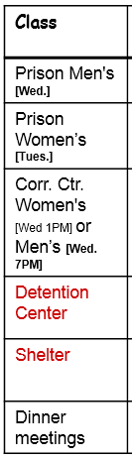
How to be involved in Thresholds
Publicity Committee
Program Committee
Membership Dv’t Committee
Fund Raising Committee
Technology Committee
Event Help
Macro Teacher
Micro teacher (1:1)
Typical schedule | Fall | Winter | Spring
7 week Class | 9/30-11/11 | 1/27-3/9 | 3/30-5/4
The Youth Center requires 3 paid background checks prior to volunteering.
If you are interested in volunteering at the youth center - we suggest doing 1 cycle at the prison and then meet with the youth center lead to discuss volunteer opportunities at the Youth Center
15
Notes:
There are also other ways to be involved in Thresholds besides going into the prison. We always need help in other areas, too. Look at the list and find something that interests you.
This slide is also in your packet of handouts. The chart shows you the dates for the cycles throughout the next year. Mark your calendars.
Women’s classes in the prison are taught on Tuesday nights.
Men’s classes in the prison and any class in the Correctional Center are taught on Wednesday nights.
You will also receive emails from the Thresholds secretary asking for volunteers for each cycle as well as dinner meeting information. Please look for those emails and respond. We always need more help in various areas. Thank you for your time.

Slide 16
Agenda
Registration
Introductions/Structured Conversation
Overview of Thresholds
6 Step Overview
Prison Information/Prison Clearance Forms
Micro/Macro Overview
  Distribute Vol. Teacher Guide & Student Manual
Outline/Detail/Demo – 6 Steps Decision Model
Going to Prison/Prison Guidelines
Open Issues
Closing Ritual & Critique of the day
Notes:
We’ll spend a few minutes reviewing the 6 steps of the Decision Making model next
This is just an overview, to give you an overall sense of the model – as we’ll go into more detail on each step later

Slide 17



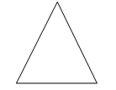


Six Steps To Decision Making
 | Define the Situation Explore characteristics of an event | ROOTS: Chance Assumption Reaction Decision | Situation Elements: Internal (feelings) External (facts) (past / present / future) | OBJECTIVE SELF AWARENESS Stepping back and observing yourself in a situation (accurate/unemotional/ impartial)
 | Set the Goal Determine what I need to achieve (have, do, be) in a situation | Where you are coming from: | Values – Important beliefs Needs – Necessity / must haves Wants –Desire or crave | Where you are going: Short-Term –accomplish right away Long-Term –takes time; multiple short-term goals Specific – what you need to do Achievable – can accomplish Measurable – know when done
 | Develop the Possibilities Develop a number of alternatives for achieving my goal | Accumulate Info: Brainstorm: Consider: | Gather info; research, talk w/ friends. List everything, incl. odd ideas Think, combine/modify | BLOCKS Jumping to Conclusions –react Again & Again –habitual thought/acts Myths – Stories from false beliefs
 | Evaluate the Possibilities Examine the possibilities in order to select one | Pick 3-5 most likely possibilities; Use worksheet | Desirability – List positive facts; Score 1 – 5 (hi) Risk – List negative things; Rate L /M / H | Others – ID who & how impacted; Rate ‘+’, ‘+/-‘, ‘-‘
 | Make the Decision Select one possibility from among the many alternatives | NOT TO DECIDE IS TO DECIDE - gives control away | A decision is not: REACTION – not thought out COMMAND – comes from outside WISH – lacks commitment to act | A decision requires: ... FREEDOM – power & control to make it CAPABILITY – ability to make it RESPONSIBILITY – willing to take it COMMITMENT – willing to accept consequences
 | Implement the Decision Act on decision, affirm commitment & assess the results | ACTION PLAN Objective-goal Strategy-what to do Tactics-how to do it Timeline-when | AFFIRMATION PLAN PERTs – Personal Eval. Rvw. Tech’s. - Symbols – reminder - Rituals – action/phrase to keep on track - Action Picture – visualize goal achieved | ASSESSMENT PLAN  Compare outcome to goal.  If NO match - work model backwards
Gifts(+) /
Limits(-)
Notes:
Handout – 1 page Thresholds “The Six Steps to Decision Making”
Refer to VTM section 2.2
Client Guide pg 39-40
Talk through as overview:
1st-lets look down the column on the left / these are symbols or icons we use to help remember each step
Next – look down the column that begins with “Define the Situation” / these are the 6 steps of the Decision Model/
A situation may require a decision
A decision will have a desired outcome/’goal
Different POSSIBILITIES could lead to the GOAL
One of the possibilities is BETTER THAN THE OTHERS
Make the decision means COMMITTING to it
Implementing is the ACTION PLAN to carry out the choice you’ve made
Ask audience to Compare Thresholds steps with their personal decision making process / ask for hand to be raised - more similar or different.
Read across each row & explain key parts of each step using an example
[EG in this class today because: CHANCE( randomly picked a room and walked in);
ASSUMPTION ( other people are in there/must be interesting);
REACTION ( someone told you to come & you obeyed)
DECISION (choose to spend day learning about thresholds –vs- shopping/exercising/reading/etc)
Continue across each row and briefly read/comment/explain each cell
SITUATION - Elements; Objective Self Awareness
GOAL – Where are you coming from; Where are you going
DEVELOP Possibilities – A.B.C.; J.A.M. [we use acromyms to help with ‘remembering’]
EVALUATE possibilities – consider DESIRABILITY; RISK; and Impact on OTHERS [build a grid/like a spread sheet with details
Make the DECISION – is Commiting/ taking responsibility for the choice
IMPLEMENTING – is developing a practical list of action to reach GOAL & establishing personal reminders – and afterwards/ analyzing how the choice played out

Slide 18
Agenda
Registration
Introductions/Structured Conversation
Overview of Thresholds
6 Step Overview
Prison Information/Prison Clearance Forms
Micro/Macro Overview
  Distribute Vol. Teacher Guide & Student Manual
Outline/Detail/Demo – 6 Steps Decision Model
Going to Prison/Prison Guidelines
Open Issues
Closing Ritual & Critique of the day
Notes:
This next section will be about the prison, how to get there and what to expect.

Slide 19
What Is Expected of You
Teach at least one set of Micro sessions per year. (3 sets per year offered)
Keep a positive outlook about your client.
Attend Thresholds events whenever possible. (2 per year)
Read and reply to Thresholds emails.
Check out the Thresholds of Chester County Facebook page & hopefully ‘like’ us
Follow the Code of Conduct
***A buddy is available to each new volunteer. This buddy will check-in periodically during the first volunteer experience to give support and answer any questions you may have. If you would like to have a buddy, please let one of the facilitators know before leaving today.
Notes:
Thresholds welcomes your participation. We have a few expectations.
Distribute and review the “Code of Conduct”. Ask participants to sign and collect.

Slide 20
Weekly 1-1 Micro Sessions
Teaching Points
Thresholds is not a faith based program.
We use first names only.
We are not counselors.
Share as much as you want. But, remember, the program is about the client, not the volunteer.
The program has a beginning and an end.
There is no communication with the client after the program ends.
This is a prison. Their rules dictate. This is not a hotel. There is no concierge service.
Notes:
Clarification is needed as to what Thresholds is and what it is not.
These items are crucial to the program and organization. If you had a different understanding and are no longer interested. We understand.

Slide 21
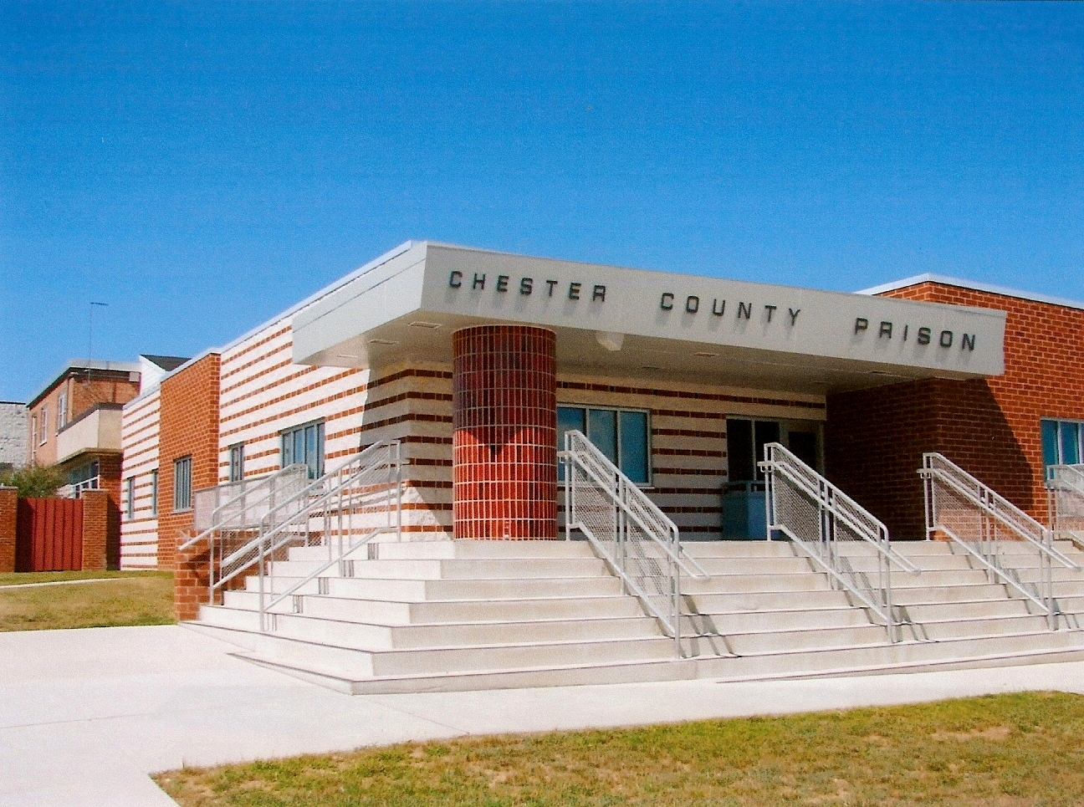
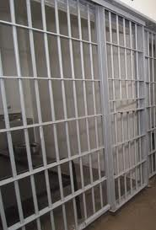
Getting to the Prison & the 1-1
Where is the Prison | Between West Chester & Kennet Sq./ [501 S Wawaset Rd, West Chester,19382]
Going thru Correctional Officer Gate / site entrance | Stop & advise: 'you are with Thresholds to see a client’
Parking | Park in lot labeled ‘Professional’ Bring only license & car key, Lock valuables in trunk.
Sign-in | Give license, car key, client’s name and cell # to correctional officer (CO) Sign visitor log as directed Receive visitor pass, token to retrieve keys and sheet with client name, block and cell # Note: any unauthorized objects/materials brought in to the institution are considered contraband / not be given to the inmate [EG - includes pens, pencils, books, pamphlets etc]
Getting to the ‘visiting area’ | Walk through metal detector; CO will buzz you through release lock door and wand you [add’l metal detector]; Walk through “school-like” hallway through door and turn right down hallway; At first barred door, buzz CO for access; Enter and wait for closure; Proceed to second barred door and wait for access
Visiting area layout & seating | Enter visiting area – open area with fixed metal tables and stools; Walk to CO outside Command Central. Give Client Pass to CO. Sit at one of the tables and wait. (CO may tell you which table to occupy.)
Waiting for client | Review what you are going to talk about with client. If client refuses session, he/she should come to tell you. [If not, the CO will advise you to leave.] Whatever you bring in….take it out with you! Don’t leave things behind.
Greeting client | Polite, respectful: How are you? How was your week?
Notes:
Remind participants – the first time you go to the prison will be for the first Macro session. So, you will be going in as a group and experience it together.
If you cannot make the first Macro, these steps outline the experience.
If you go to the pre-release, it is a more informal.

Slide 22
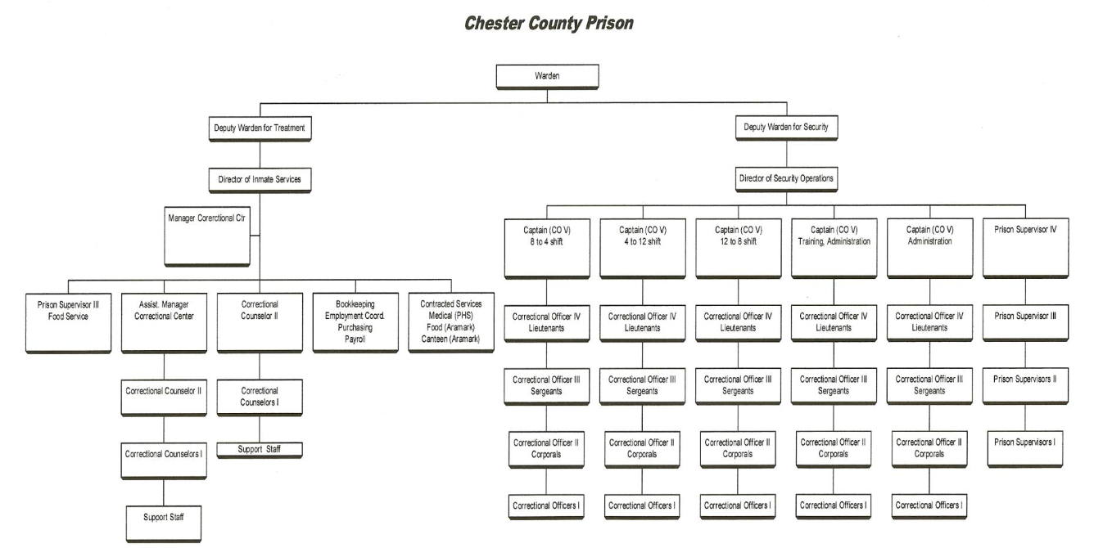
Ed McFadden - WARDEN
Geo. Roberts -
DIR. INMATE SVCS.
Tim Mulrooney - Mgr. Corr. Ctr.
Mike Iswalt - Counselor
[Threshold Liason]
Many more

Slide 23
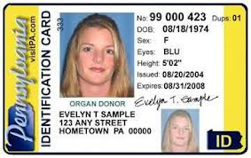
Thresholds – Decision Making
Prison Clearance Forms
Thresholds does not retain Prison Clearance form documentation
The forms are collected, delivered to and reviewed by Prison Admin.
Thresholds does not know who will gain access, or if denied - why
Prison decision to withhold clearance is for the safety/well-being of all parties
  Determined by Prison Security judgement
Possible reasons access may be denied:
  Unresolved legal matters (tickets, liens, judgments, etc.)
  Association with an inmate at the prison
  Previous criminal history
Clearance is granted for a 2-yr. period / the Prison requires re-submission on a 2-yr. cycle
Add’l Youth Center Clearance
PA State Police-Criminal background check
Childline Protective Services-Child Abuse Clearance
FBI Fingerprint
example-ID

Slide 24
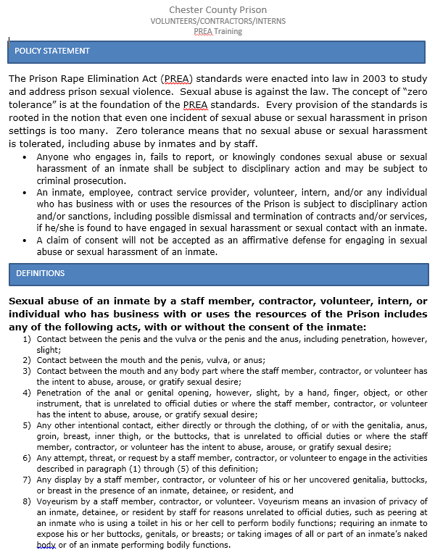

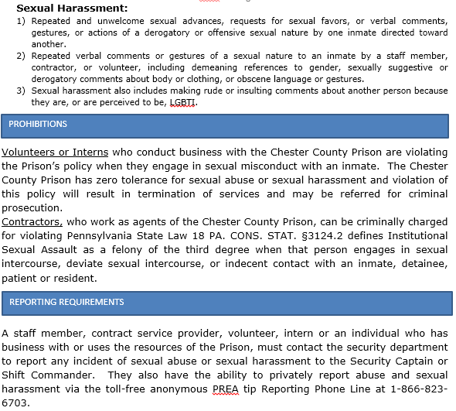

Slide 25
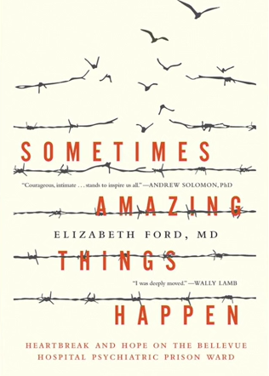
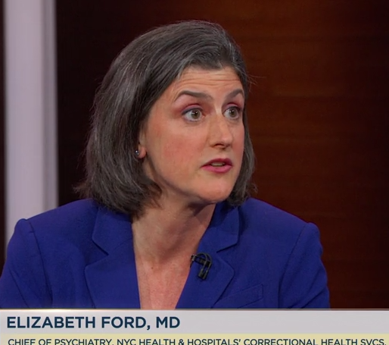
Thresholds – Decision Making
Working with Prison Clients
Elizabeth Ford Chief of Psychiatry, NYC Health & Hospitals Correctional Health Svcs.
Daily Show, May 30, 2017
Psychiatric treatment of the incarcerated [approx. 5 min.]
http://www.cc.com/video-clips/o1tm1d/the-daily-show-with-trevor-noah-elizabeth-ford---examining-mental-health-and-the-prison-system-in--sometimes-amazing-things-happen-

Slide 26
Break

Slide 27
Agenda
Registration
Introductions/Structured Conversation
Overview of Thresholds
6 Step Overview
Prison Information/Prison Clearance Forms
Micro/Macro Overview
  Distribute Vol. Teacher Guide & Student Manual
Outline/Detail/Demo – 6 Steps Decision Model
Going to Prison/Prison Guidelines
Open Issues
Closing Ritual & Critique of the day
Notes:
Now we will discuss the Macro and Micro session for a better understanding.

Slide 28
How We Teach It
Thresholds is composed of two parts: classroom training and one-on-one individual training.
Macro (Classroom)
Presentations that teach the decision making steps
Activities to reinforce learning objectives
Generic Examples
Group Discussion
Micro (One-On-One)
Volunteers meet participants in a safe environment
Allows open dialogue about specific personal goals and actions needed to achieve
Reinforces the six step process
Notes:
Reiterate that each class is a threshold step…6 classes for the steps and 1 graduation class and for the men’s they also have an introductory session.
Meetings with your client for Micro session will take place in the meeting area of the prison, right by “Command Central”. There is plenty of security.
The Micro session really makes the program. It is the aspect of Thresholds that the clients value most.

Slide 29
Weekly 1-1 Micro Sessions
1-1 Micro Meeting
Teach, Review & Reinforce
Define Situation
Set Goal
Develop Possibilities
Evaluate Possibilities
Make Decision
Implement Decision
Agenda item
Greeting
Questions/discussion about previous macros/workbook mtl.
Latest macro & workbook mtl. review/discussion
Other issues / questions / concerns
Timing
[1-2 min.]
[0-15 min.]
[30-40 min.]
[0-30 min.]
approx. 1 hr
Notes:
A sample Micro session may look like this chart.
We will be learning about the Micro sessions today. All materials needed are provided for you.

Slide 30
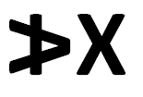
Men Women
7 weeks [6 Steps + Graduation] | 7 weeks [6 Steps + Graduation]
Week 1 = Intro and Step 1 | Week 1 = Intro and Step 1
Prison and Correctional Center | Prison and Correctional Center
Wednesdays = Prison & Correctional Center | Tuesdays = Prison Wednesdays = Correctional Center [NA-2019 Spring]
First Micro combines Intro [session 1] and Step 1 [session 2] and begins after first Macro | First Micro combines Intro [session 1] and Step 1 [session 2] and begins after first Macro
Volunteers are invited/encouraged to attend the first Macro to meet your client, enter as a group, and get accustomed to the prison set-up.
***Each new volunteer can have a buddy assigned to him/her who will check-in periodically during the first volunteer experience to give support and answer any questions you may have.
Notes:
Read and explain slide
Fyi 1- Corr. Ctr. May be men or women
Fyi 2 –the person you worked with during the red & discuss break-outs may have been your ‘Buddy’

Slide 31

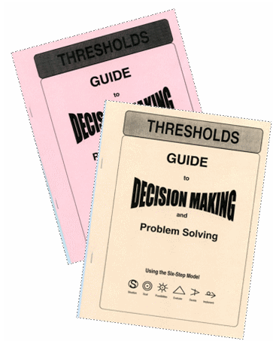
Distribute Vol. Teacher Manual & Student Guide
We’ll refer you to pages in both the Manual & Guide during the day
31
Notes:
31
Take time to browse through the materials and make sure participants understand the use of each. You will be flipping back and forth between these materials today. We will work in small groups to understand how these materials can work for you. Everything you need for the Micro session is contained in these materials. Take time to look at the Table of Contents in the manual and the client guide to understand the contents.

Slide 32
Agenda
Registration
Introductions/Structured Conversation
Overview of Thresholds
6 Step Overview
Prison Information/Prison Clearance Forms
Micro/Macro Overview
  Distribute Vol. Teacher Guide & Student Manual
Outline/Detail/Demo – 6 Steps Decision Model
Going to Prison/Prison Guidelines
Open Issues
Closing Ritual & Critique of the day
The next part of the training will use an example of ‘Staying Sober’ to demo the “Decision Model; after that – we’ll go through each step in detail and have you apply the model to a decision you’ve made recently – so start thinking of one
Notes:
The next section of the agenda deals with the specifics of teaching in a Micro.

Slide 33
Thresholds – Decision Making
Introduction Session
Reinforce and acquaint client with program.
Become acquainted with each other.
  Introduce yourself.
  Learn the client’s history.
  Agree on the schedule and the commitment.
Become acquainted with the program.
  Explain the basics of the program.
  Review what the client has learned in the Macro.
  Begin to use the Guide
  Closing Ritual
Notes:
The introduction occurs during the first Macro session (if you attend) and continues during your first one-on-one Micro session with your client.

Slide 34
Thresholds – Decision Making
Micro Session One Practice (Introduction)
Work in your small group.
Read pages: i, 1, 39-40 in the Client Guide.
Ask clarifying questions, such as, “Which activities seem to work best? What does______ mean?”.
Review lesson plan in manual section 8.1-8.2, pages 78-80, 89-93, 96, 118-119.
Review/complete activities/guide pages for this step: None
Notes:
Follow this chart with your small group leader to learn how to have a Micro session.
This may be a good time to distribute the Readings Summary handout and explain how the materials work.
Key 1:1 is the client guide! Most everything you need to conduct a 1:1 is in here. This is your tool to walk through program with the client. The VTM is messy! You will be flipping pages, etc…you will get used to it by the time you leave today. We want you to understand everything but you may not use everything each class…also, you have to take into account your and your client’s personality…some people want to talk, and don’t like the book, some love the book…read your client and adjust each week! The ride home is a great time to decompress about how the session went. Even if you never open the guide you can still walk your client through the 6 step model….Some folks don’t have visitors so you are the only contact to the outside world…they will want to chat, and do that…but bring it back and transition to thresholds. You should only be there about 1 hour per session…if you can’t get done or done too early reassess what you are doing and talk to your buddy to see how you can make adjustments. You can see in the lesson plan…start with structured conversation and you always end with the closing ritual…
A tool to make the step more practical and reflective. Look at the Reading Summary handout that tells you where to go and what to read in the Client Guide and Macro Teacher Manual

Slide 35
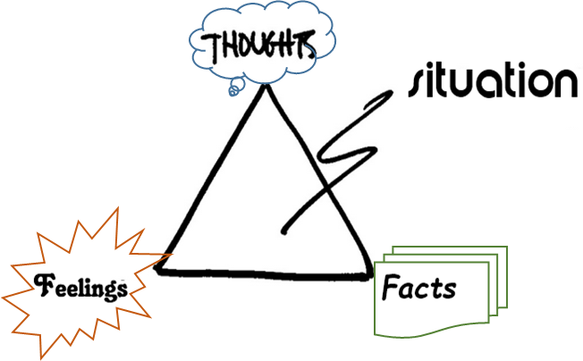
Thresholds – Decision Making
Step 1. Define the Situation
Explore the characteristics of event[s] that make up my life
Roots:
  Chance - a happening outside your control
  Assumption - an unexamined belief; may or may not be accurate
  Reaction - a quick, unthinking response
  Decision - a carefully considered choice
Step 1: Define the Situation
Situation: __________________________
__________________________
Root Cause (CARD) _________________
The Facts: _________________________
Your Feelings?______________________
Gifts / Limits? ______________________
Gifts (positives) / Limits (negatives): what’s good & bad about what you think / feel [like pro vs. con list]
Objective self-awareness: step back & ‘try to see’ objectively [not subjectively] what’s happening
Notes:
What is a situation? Review the symbol for the step and what it means. Millions of situations happen to us each day…ask for examples of little situation, ask for examples of big situations (death, marriage, new job, loss job, divorce,…)…we all have 2 in common…born and we are at the thresholds volunteer training…to dive into the situation look at 4 parts…root cause (go through the situation we have in common..all at vtw)…facts, feelings (discuss how hard sometimes to separate the 2 of these…) then gifts and limits…umbrella over this whole step is osa

Slide 36
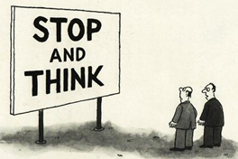

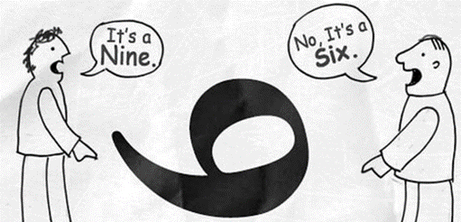
Thresholds – Decision Making
Objective Self -Awareness
start here
Ability to be a dispassionate witness, a non-judgmental observer of oneself and a situation
Not leaving a situation, but being able to both be in a situation and step outside to view it - without personal bias or prejudice
“It sort of makes you stop & think, doesn’t it.
The ability to ‘step-back’ and look at yourself in a situation
– then accurately report your thoughts and actions
Which woman do you see?
Old / Young / Both?
Notes:
Great picture we use in the macro class—your own biases may only allow you to see 1 person verses 2…How you look at it.
Perception intro from Macro manual page 17
36

Slide 37
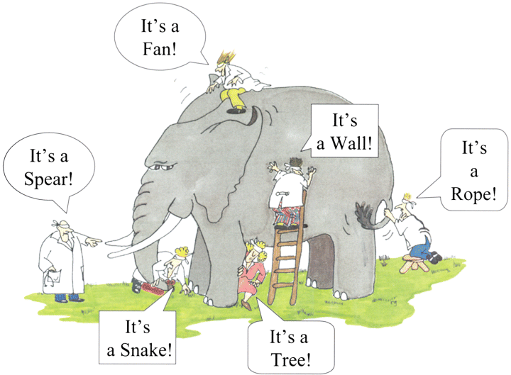
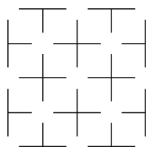
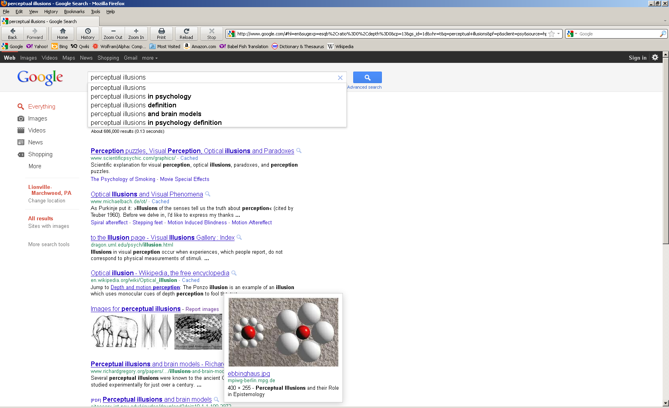
More fun with
cognitive bias
& optical illusions
How many ‘white circles’ are in the grid above?
Experiences & Expectations effect our interpretation of a situation
Which ‘red’ circle is bigger - L or R

Slide 38
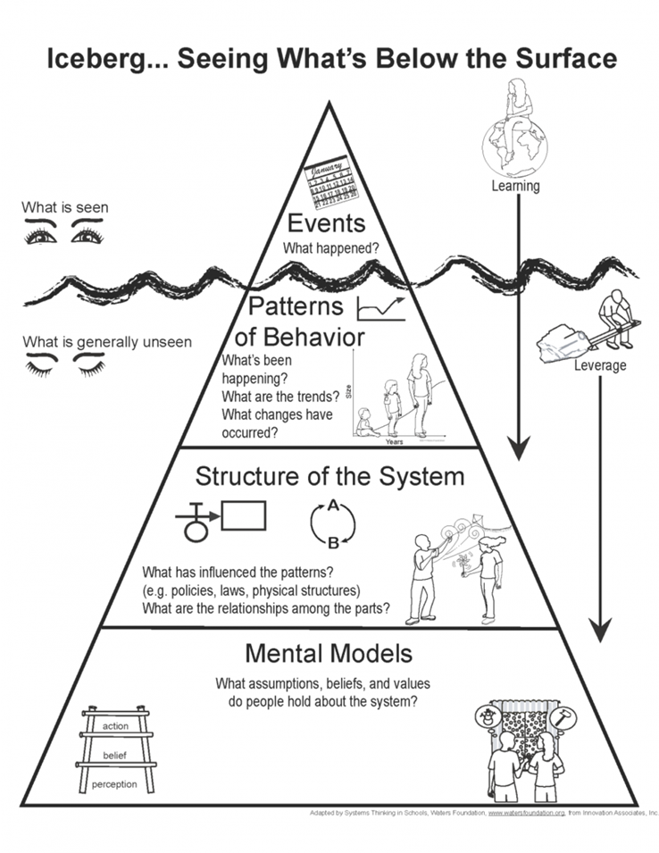

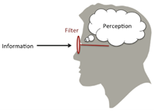
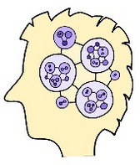
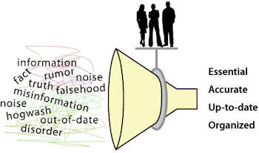
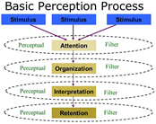


Step 1 starts the decision process
Try to be Objectively Self Aware
Think about/question initial fact/feeling/gift/limit perception[s]
Consider a ‘new’ view
Notes:
Review the symbol and where you are…what it means…example when you have a disagreement and you in the heat of the moment think you are an angel and the other person is picking on you…next day, re look at it and realize your own contribution…
A tool to make the step more practical and reflective.

Slide 39
Decision Making Example: Staying Sober
STEP 1: DEFINE THE SITUATION
Situation:
Arrested for DUI for the 3rd time. Ended up being sentenced to 12 months due to repeat offending.
The Root Cause (CARD):
Decision to drive when I had to much to drink
The Facts:
Left the bar after drinking for a couple of hours; pulled over on Rte. 82; 3rd DUI; Serving 12 month sentence
Your Feelings?
Regretful, pissed-off, disbelief, annoyed
Gifts / Limits?
Know I have to get help with addiction(+); Sober in Prison (+); Can’t drive to work (-); Can’t work in Prison (-)
Roots:
  Chance
  Assumption
  Reaction
  Decision
Notes:
What is a situation? Review the symbol for the step and what it means. Millions of situations happen to us each day…ask for examples of little situation, ask for examples of big situations (death, marriage, new job, loss job, divorce,…)…we all have 2 in common…born and we are at the thresholds volunteer training…to dive into the situation look at 4 parts…root cause (go through the situation we have in common..all at vtw)…facts, feelings (discuss how hard sometimes to separate the 2 of these…) then gifts and limits…umbrella over this whole step is osa

Slide 40
Thresholds – Decision Making
Micro Session Two Practice (Step 1)
Work in your small group.
Read pages: 2,4,7 in the Client Guide.
Ask clarifying questions.
Review lesson plan in manual section 8.3, pages 81-82, 120
Review/complete activities/guide pages for this step: page 9, Decision Making Worksheet step 1
Notes:
VTM section 3.2
A tool to make the step more practical and reflective.

Slide 41

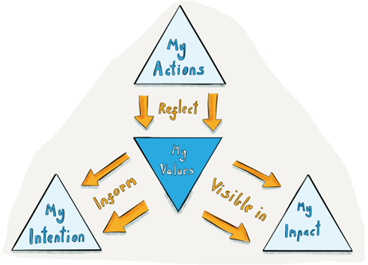
Thresholds – Decision Making
Step 2. Set the Goal
To determine what I need to achieve in a situation
Where are you coming from?
  Values (what’s important, family, beliefs)
  Wants (like to have it) and needs (must/required)
  Consequences
Where are you going?
  SHORT & LONG TERM (combine short to reach long term goals)
  S pecific – detailed/descriptive, clear to others
  A chievable – can I do it
  M easurable – how will I know when it’s done + timing
Notes:
HO – Thresholds Decision-Making Worksheet
Refer to VTM section 2.2.2
You’ve thought about the situation and have realized there is a need to do something;
- something that will be beneficial and good for you – but what should it be;
This is a fork in the road, an opportunity NOT to REACT – but to DECIDE;
You need a goal that will stop you from reacting, that is appealing & desirable enough to keep you moving toward it;

The symbol we use for the ‘Set the Goal’ step is a target or bull's-eye [a visual to aim for]
Consider where you are coming from:
Values - what you respect, regard highly, core belief
Wants - desirable / nice to have [eg.: food- ‘dessert’]
Needs - limits / musts / absolute requirements [eg.: food-protein]
Consequences for your self and especially Others
Think about where you are going:
Specific – not lose weight/ but lose 10 lbs by eating less junk food
Achievable – realistic / you can do it
Measurable – When date &/or time, lose 10 lbs by eating less junk food during nxt 2 mos.
And Remember – Goals can have a longer duration
They can be short term – in the near future or long term / probably made up of a number of short term goals
Since it’s almost time to break for lunch – lets have a lunch goal
Who wants a gourmet meal that lasts 2 hours?
[not realistic nor needed & the consequence would be we’re behind schedule or you get home late]
How about a healthy choice of salad or sandwiches you can eat in 20 min. and still have time to talk to peers for 5-10 min.
That’s S.A.M.

Slide 42
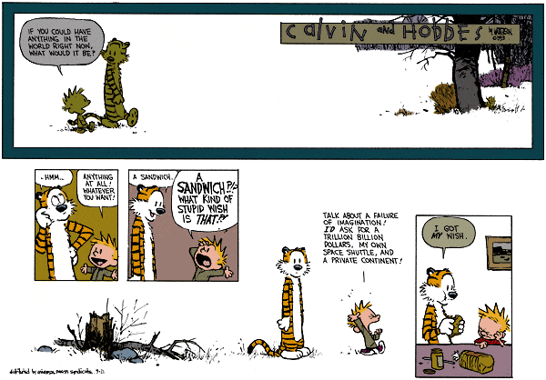
Set small – short term goals
Then move on
To medium and long term
Notes:
VTM section2.2.2

Slide 43
Decision Making Example: Staying Sober
STEP 2: SET THE GOAL: Make it Specific, Achievable, Measurable (SAM)
Wants/Needs:
Want to not come back to jail; want & need to stay sober.
Values:
Value family and they need me to be working and taking care of them.
Goal:
Stay sober everyday.
Is it SAM? - Yes

Slide 44
Thresholds – Decision Making
Micro Session Three Practice (Step 2)
Work in your small group.
Read pages: 10,11,12 in the Client Guide.
Ask clarifying questions.
Review lesson plan in manual section 8.4, page 83, 104-105
Review/complete activities/guide pages for this step: bottom of page 13, artform “Attitude” page 104-105 in manual, Decision Making Worksheet step 2
Notes:
VTM section 3.2
A tool to make the step more practical and reflective.
Look at the handout that tells you where to go and what to read in the Client Guide and Macro Teacher Manual

Slide 45
Lunch

Slide 46
Agenda
Registration
Introductions/Structured Conversation
Overview of Thresholds
6 Step Overview
Prison Information/Prison Clearance Forms
Micro/Macro Overview
  Distribute Vol. Teacher Guide & Student Manual
Outline/Detail/Demo – 6 Steps Decision Model
Going to Prison/Prison Guidelines
Open Issues
Closing Ritual & Critique of the day
Notes:
We will continue with learning about the steps and how to apply them in a Micro session.

Slide 47

Thresholds – Decision Making
Step 3. Develop the Possibilities
To develop a number of alternatives for achieving my goal
Techniques:
  A ccumulate information
    Variety of sources (friends, experts, internet, newspapers, books)
  B rainstorm
    List everything (incl. far-out ideas; reject nothing)
    Mind Map - use the target/spokes icon format
  C onsider
    Contemplate (take time to think, combine/modify ideas)
Avoid common ‘blocks’:
  Jumping to conclusion: pre-judging/reacting to an idea
  Again and again: doing things the ‘same old way’
  Myths: stories, based on false beliefs or prejudice
A
B
C
JAM
Notes:
VTM section 2.2.3
Remind participants that brainstorming means accepting all ideas. Each one will be analyzed in the next step. Step 3 is not for judgment. It is to get ideas out to consider.
Any time you have a goal, you must think of all the possible ways to accomplish this goal. This takes a bit of time which helps the clients slow down and think rather than react.
Here we have 2 acronyms – ABC and JAM. These help participants remember the specifics of each step. These particular ones help clients consider many possibilities rather than just one or two.

Slide 48
Thresholds – Decision Making
Step 3. Develop the Possibilities
Possibility
Possibility
Possibility
•
Possibility
Possibility
Possibility
Possibility
Possibility
Step 3 Think of the Possibilities: Accumulate, Brainstorm, Consider (ABC’s)
Notes:
This Refer to VTM section 2.2.3
Possibilities are recorded on a wheel, not a list. This prevents an early ordering of possibilities so that each one can be carefully considered. More spokes can be added as needed.
If an example is needed, use the activity of thinking of all the possibilities of what you can do with a brick. Take all answers as possible without any judgment.
48

Slide 49
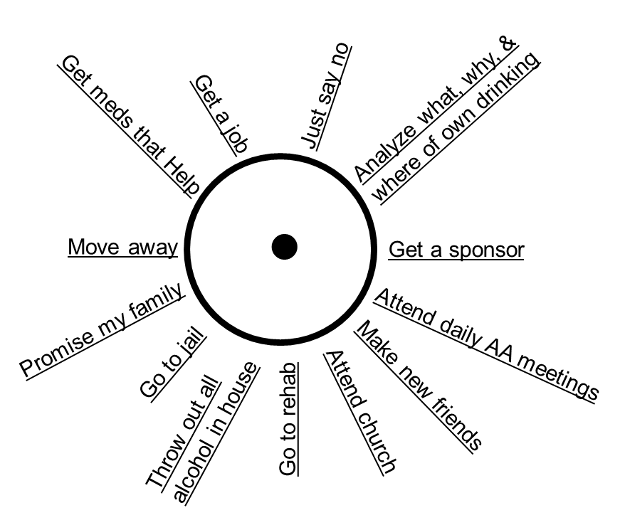
Decision Making Example: Staying Sober
STEP 3: DEVELOP POSSIBILITIES – Accumulate, Brainstorm, Consider (ABC’s)
Did you avoid JAM’s? - yes

Slide 50
Thresholds – Decision Making
Micro Session Four Practice (Step 3)
Work in your small group.
Read pages: 14,15 in the Client Guide.
Ask clarifying questions.
Review lesson plan in manual section 8.5, page 84, 115-116, 102-103
Review/complete activities/guide pages for this step: bottom of page 17, Decision Making Worksheet step 3
Notes:
VTM section 2.2.3
A tool to make the step more practical and reflective. Work in your small group to review the materials and complete the selected activities.

Slide 51
Thresholds – Decision Making
Step 4. Evaluate the Possibilities
Carefully examine the possibilities in order to select one
1. Eliminate all irrelevant possibilities
2. Chart reasonable possibilities in terms of 2 factors
    Note: score ‘desirability’ before rating ‘risks’
Possibility | Desirability (5=most 1=least) [advantages of the possibility/positives that can aid success] | Risk ( L, M, H) [disadvantages/could cause failure]
Possibility 1 | List details why desirable | List Risks
Possibility 2 | List details why desirable | List Risks
Possibility 3 | List details why desirable | List Risks
Score 1-5
Rate L/M/H
Score 1-5
Rate L/M/H
Score 1-5
Rate L/M/H
3. Identify effect on others of ‘first choice’ possibility (list ‘others’, describe effect, rate [+] or [-] )
Who | How effected | +/-
4. Considering effect on others, does choice of best possibility change?
Notes:
Evaluate---symbol is a triangle…how many sides? Guess how many things we look at when we evaluate…we look at desirability, risk and effect on others…what would be a safe choice…when looking at things that are important to you? 5 and l…when look at the people you value and how the possibility would effect them would you change your choice?

Slide 52
Decision Making Example: Staying Sober
STEP 4: EVALUATE POSSIBILITIES – likely to help reach goal
Pick Possibilities for evaluation
Which seem more desirable?
Which seem less risky?
Possibilities for Evaluation

Slide 53
Decision Making Example: Staying Sober
Step Four: Evaluate the Possibilities [Think of & note facts about each Alt that are ‘desirable’ or ‘risky’]
POSSIBILITY |  | DESIRABILITY ❶Stay sober; ❷Have support ❸Stay out of jail |  | RISK
 |  | (Most: 5 – Least: 1) |  | (L, M, H)
Get Counseling |  | Personal help Focus on sobriety |  | Costs money Need transportation May not be recovering alcoholic
Attend Daily AA Meetings
Get AA Sponsor
Go to Rehab
POSSIBILITY |  | DESIRABILITY ❶Stay sober; ❷Have support ❸Stay out of jail |  | RISK
 |  | (Most: 5 – Least: 1) |  | (L, M, H)
Get Counseling |  | Personal help Focus on sobriety |  | Costs money Need transportation May not be recovering alcoholic
Attend Daily AA Meetings |  | Support from others with same issues Meet new friends Develop network |  | Need to find meetings Need transportation Need to make time to attend
Get AA Sponsor
Go to Rehab
53

Slide 54
Decision Making Example: Staying Sober
Step Four: Evaluate the Possibilities [Think of & note facts about each Alt that are ‘desirable’ or ‘risky’]
POSSIBILITY |  | DESIRABILITY ❶Stay sober; ❷Have support ❸Stay out of jail |  | RISK
 |  | (Most: 5 – Least: 1) |  | (L, M, H)
Get Counseling |  | Personal help Focus on sobriety |  | Costs money Need transportation May not be recovering alcoholic
Attend Daily AA Meetings |  | Support from others with same issues Meet new friends Develop network |  | Need to find meetings Need transportation Need to make time to attend
Get AA Sponsor |  | Personal help Work with another alcoholic Learn to work the program |  | Will require work
Go to Rehab
POSSIBILITY |  | DESIRABILITY ❶Stay sober; ❷Have support ❸Stay out of jail |  | RISK
 |  | (Most: 5 – Least: 1) |  | (L, M, H)
Get Counseling |  | Personal help Focus on sobriety |  | Costs money Need transportation May not be recovering alcoholic
Attend Daily AA Meetings |  | Support from others with same issues Meet new friends Develop network |  | Need to find meetings Need transportation Need to make time to attend
Get AA Sponsor |  | Personal help Work with another alcoholic Learn to work the program |  | Will require work
Go to Rehab |  | Inpatient program Intense help Learn new tools |  | May be expensive Can’t earn money Only temporary
54

Slide 55
Decision Making Example: Staying Sober
Step Four: Evaluate the Possibilities [Score desirability of each Alt.]
POSSIBILITY |  | DESIRABILITY ❶Stay sober; ❷Have support ❸Stay out of jail |  | RISK
 |  | (Most: 5 – Least: 1) |  | (L, M, H)
Get Counseling |  | Personal help Focus on sobriety | 3 | Cost money Need transportation Counselor may not be recovering alcoholic
Attend Daily AA Meetings |  | Support from others with same issues Meet new friends Develop network | 5 | Need to find meetings Need transportation Need to make time to attend
Get AA Sponsor |  | Personal help Work with another alcoholic Learn to work the program | 5 | Will require work
Go to Rehab |  | Inpatient program Intense help Learn new tools | 4 | May be expensive Can’t earn money Only temporary
55

Slide 56
Decision Making Example: Staying Sober
Step Four: Evaluate the Possibilities [Rank risk of each Alt.]
POSSIBILITY |  | DESIRABILITY ❶Stay sober; ❷Have support ❸Stay out of jail |  | RISK
 |  | (Most: 5 – Least: 1) |  | (L, M, H)
Get Counseling |  | Personal help Focus on sobriety | 3 | Cost money Need transportation Counselor may not be recovering alcoholic | H
Attend Daily AA Meetings |  | Support from others with same issues Meet new friends Develop network | 5 | Need to find meetings Need transportation Need to make time to attend | M
Get AA Sponsor |  | Personal help Work with another alcoholic Learn to work the program | 5 | Will require work | L
Go to Rehab |  | Inpatient program Intense help Learn new tools | 4 | May be expensive Can’t earn money Only temporary | H
56

Slide 57
Decision Making Example: Staying Sober
Step Four: Evaluate the Possibilities [ID 2 highest scoring Alts.]
POSSIBILITY |  | DESIRABILITY ❶Stay sober; ❷Have support ❸Stay out of jail |  | RISK
 |  | (Most: 5 – Least: 1) |  | (L, M, H)
Get Counseling |  | Personal help Focus on sobriety | 3 | Cost money Need transportation May not be recovering alcoholic | H
Attend Daily AA Meetings | 2 | Support from others with same issues Meet new friends Develop network | 5 | Need to find meetings Need transportation Need to make time to attend | M
Get AA Sponsor | 1 | Personal help Work with another alcoholic Learn to work the program | 5 | Will require work | L
Go to Rehab |  | Inpatient program Intense help Learn new tools | 4 | May be expensive Can’t earn money Only temporary | H
57

Slide 58
Decision Making Example: Staying Sober
Step Four: Evaluate the Possibilities
The final part of the evaluation process involves considering
HOW OTHERS COULD BE AFFECTED BY YOUR CHOICE:
Examine your ‘leading prospects’ for FOCUS
[possibilities that score & rate best /hi-desirable & low risk].
What is motivating you to select a certain possibility [facts or feelings]?
Does considering Impact on others change the possibility that seems to be leading?
Who? | How impacted? | +/-
Spouse | Drive to meetings, relieved getting help | +
Family, friends | Need to understand this is first priority of time | + and -
Does this change your overall rating? If yes – change your choice. In either case - - Circle your choice.
58

Slide 59
Thresholds – Decision Making
Micro Session Five Practice (Step 4)
Work in your small group.
Read pages: 19,22,23 in the Client Guide.
Ask clarifying questions.
Review lesson plan in manual section 8.6, page 85, 110-111
Review/complete activities/guide pages for this step: page 24, Decision Making Worksheet step 4
Notes:
VTM section 2.2.4
A tool to make the step more practical and reflective.

Slide 60
Thresholds – Decision Making
Step 5. Make the Decision
Select one possibility from among the alternatives
A good decision is one that results from using the Process:
1. Define Situation
2. Set Goal
3. Develop Possibilities
4. Evaluate Possibilities
5. Make Decision
Choosing not to decide is a decision
  Realize that circumstance or others may fill the void
Using the decisional process does not guarantee that you will reach or like the outcome, it does increase the odds that you’ll reach your goal
A good outcome may result from circumstances beyond your control or luck
A decision is not:
  A reaction (not thought-out)
  A command (comes from another)
  A wish (lacks commitment to act)
  Commitment to a decision occurs when you Acknowledge the decision, Accept it as valid, and Agree to carry it out
Observations about decisions:
Notes:
HO – Thresholds Decision Making Worksheet
VTM section 2.2.5
It may seem as if the decision was made at the end of step 4 [Evaluate the Possibilities]
An in a sense it - preliminarily/probably / approximately
Step 5 Make the Decision is the point when the analysis and considerations you’ve thought about becomes real;
You have to take ownership of the possibility you select and commit to it – it’s yours - not your brother’s or sister’s or friend’s or anyone else
Commitment to a decision occurs when you acknowledge the decision, accept it as valid, and agree to carry it out

Slide 61
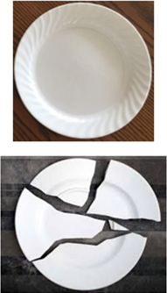
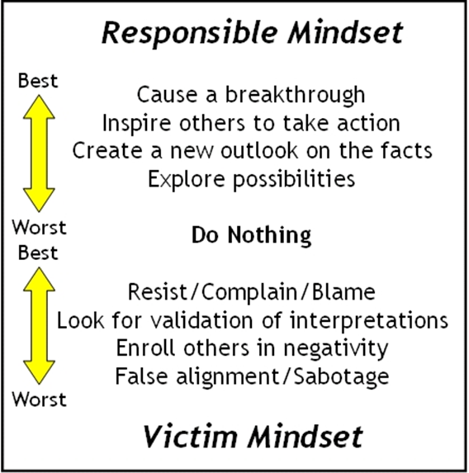
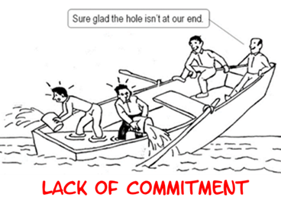
RESPONSIBILITY – answerable, obligated
having a duty to deal with something
sense of obligation to someone
without considering own self-interest
‘I must do something’
solves more problems than
‘Something must be done’
Grab a plate & throw it on the ground.
- okay, done
Did it break?
- yes
Now say sorry to it.
- sorry.
Did it go back to the way it was before?
- no
Do you understand???
sure glad
the hole
isn’t
at our end

Slide 62
Decision Making Example: Staying Sober
Step Five: Evaluate the Possibilities [ID best scoring Alt. with least negative impact on people]
POSSIBILITY |  | DESIRABILITY ❶Stay sober; ❷Have support ❸Stay out of jail |  | RISK
 |  | (Most: 5 – Least: 1) |  | (L, M, H)
Get Counseling |  | Personal help Focus on sobriety | 3 | Cost money Need transportation May not be recovering alcoholic | H
Attend Daily AA Meetings | 2 | Support from others with same issues Meet new friends Develop network | 5 | Need to find meetings Need transportation Need to make time to attend | M
Get AA Sponsor | 1 | Personal help Work with another alcoholic Learn to work the program | 5 | Will require work | L
Go to Rehab |  | Inpatient program Intense help Learn new tools | 4 | May be expensive Can’t earn money Only temporary | H
62

Slide 63
Thresholds – Decision Making
Micro Session Six Practice (Step 5)
Work in your small group.
Read pages: 25, bottom of 26, top of 30, 31 in the Client Guide.
Ask clarifying questions.
Review lesson plan in manual section 8.7, page 86, 112
Review/complete activities/guide pages for this step: bottom of page 29, Decision Making Worksheet step 5
Notes:
VTM section 2.2.5
A tool to make the step more practical and reflective.
Look at the handout that tells you where to go and what to read in the Client Guide and Macro Teacher Manual

Slide 64
Thresholds – Decision Making
Step 6. Implement the Decision
Complete the decisional process – 3 stages (the 3 “A’s”)
Actions:
  Decision: what you will do
  Tactics: details of the game plan to implement the decision
  Timeline: Tactics in chronological order
Affirmation plan (keeps you on track):
  Reminders: help gauge your progress
    (to-do list, diary, weight chart, savings accnt/ book / PERT’s – personal eval. review techniques)
  Symbols
  Rituals
Help recall your objective, rehearse tactics, and reconfirm commitment
Assessment:
  Check results against goal - to determine how well the decision worked
  If mark missed/review decisional process steps in reverse
    Were tactics appropriate? / How well were possibilities evaluated? / Should other possibilities been considered? / Was the goal realistic? / Was the situation clearly understood?
    Mistakes can be your best friend – if you take the time to learn from the experience
A plan is not an end in itself – but the preparation for timely action
Notes:
VTM section 2.2.6
This may be the most important step. Many people make decisions, but then do nothing about them. They can’t stick to the decision because they have no specific plan to implement it. This is where a checklist, pictures, reminders, etc. are crucial to an outcome from deciding, not reacting.
Thresholds uses three A’s for this step.
It is important to remember that not every decision will result in a perfect outcome. But, if the steps are followed, it is more likely to be a better outcome. Even when the outcome is not ideal, much learning and understanding can result from following the decision making process.

Slide 65
Thresholds – Decision Making
Micro Session Seven Practice (Step 6)
Work in your small group.
Read pages: top of 32, bottom of 33,34,35, top of 36 in the Client Guide.
Ask clarifying questions.
Review lesson plan in manual section 8.8, page 87, 113-114
Review/complete activities/guide pages for this step: bottom of page 36, all of page 37, Decision Making Worksheet step 6
Give your client a congratulatory card if you wish. No envelopes, no staples, no gifts
Notes:
VTM section 2.2.6
A tool to make the step more practical and reflective. Work in your small group to review the materials and complete the selected activities.

Slide 66
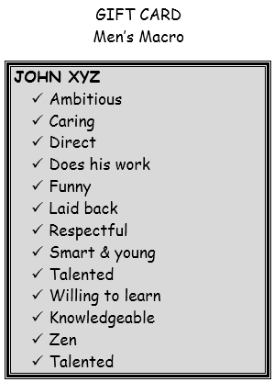
Thresholds – Decision Making
Graduation (Macro Only)
Celebrate Learning
Micro teachers are invited to attend.
Steps are reviewed.
Clients share gift cards.
Certificates are distributed.
‘Gifts’ solicited from peer Clients & Micro Tchr.
Decisions are celebrated.
Music from artfoms.
Cake and juice are served!!
I am unique! I am important! I am irreplaceable!
Notes:
Wonderful situation or event! See your 1:1 in group environment. Some folks never graduated from anything. Positive,…worth attending if your schedule allows. If you can’t make it TELL them at your last 1:1. If something happens and you thought you were going to go and you can’t then call the macro teacher to give your client a message! Gift cards…wonderful to see their faces light up. Cake and juice is a big deal! Enjoy it.

Slide 67
Break

Slide 68
Agenda
Registration
Introductions/Structured Conversation
Overview of Thresholds
6 Step Overview
Prison Information/Prison Clearance Forms
Micro/Macro Overview
  Distribute Vol. Teacher Guide & Student Manual
Outline/Detail/Demo – 6 Steps Decision Model
Going to Prison/Prison Guidelines
Open Issues
Closing Ritual & Critique of the day
Notes:
Have participants share what burning question they have about the prison – only one question per person.

Slide 69
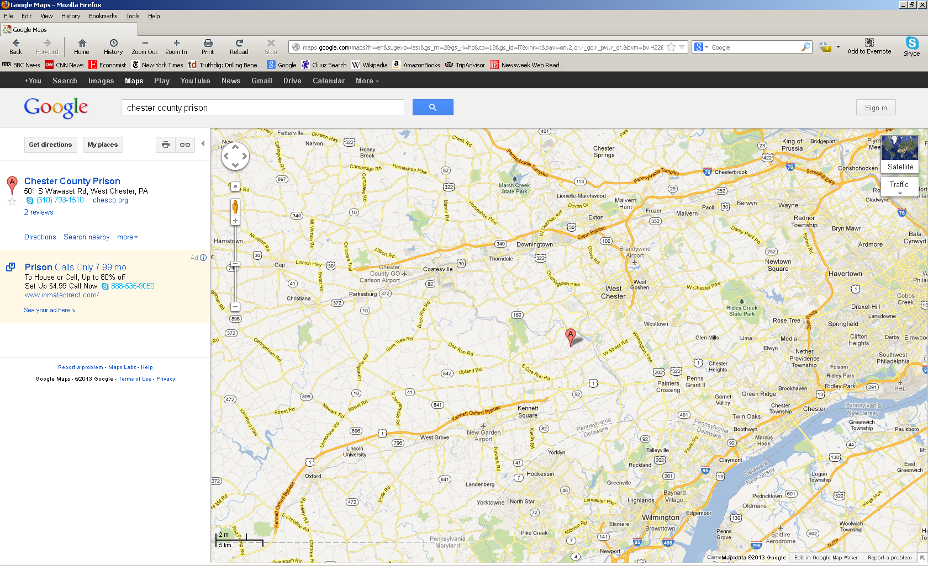
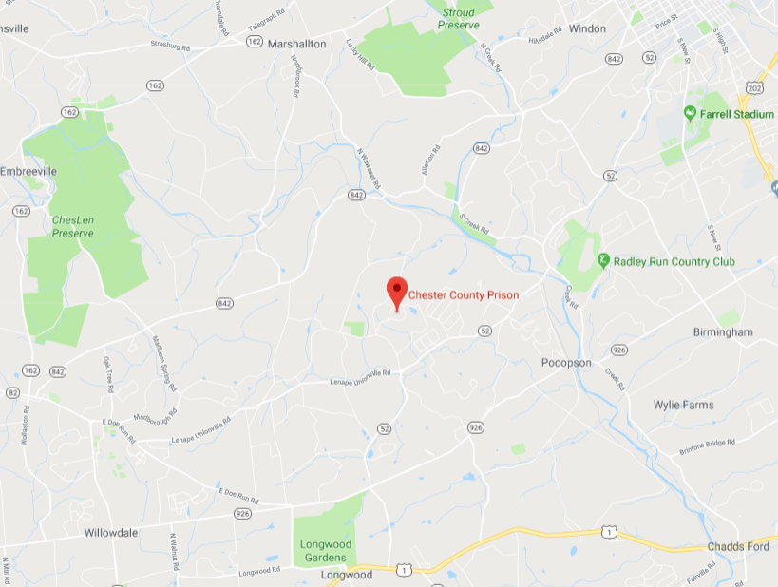
Getting to the Prison
Notes:
Remember:
You are going to someone else’s house and we must respect their rules and their environment. The prison can ask people to no longer participate if they are not following the rules and procedures.

Slide 70
Getting to the Prison
From Exton, PA (Routes 30 & 100):
1. Head southeast on PA-100 S About 3 mins | go 2.7 mi total 2.7 mi
2. Take the exit onto US-202 S About 4 mins | go 3.7 mi total 6.5 mi
3. Exit onto US-322 BUS W/S High St toward High St About 1 min | go 0.9 mi total 7.3 mi
4. Turn left onto W Rosedale Ave About 2 mins | go 0.9 mi total 8.2 mi
5. Turn left onto PA-52 S/Lenape Rd Continue to follow PA-52 S About 5 mins | go 2.5 mi total 10.7 mi
6. Turn right onto PA-52 S/Lenape Rd About 3 mins | go 2.0 mi total 12.8 mi
7. Turn right onto S Wawaset Rd About 2 mins | go 0.5 mi total 13.3 mi
8. Turn right to stay on S Wawaset Rd Destination will be on the right | go 0.2 mi total 13.4 mi
From Coatesville, PA (Routes 30 & 82)
1. Head west on PA-82 S/US-30 BUS W | go 0.4 mi total 0.4 mi
2. Take the 2nd left onto PA-82 S/Strode Ave Continue to follow PA-82 S About 18 mins | go 10.1 mi total 10.5 mi
3. Turn left onto PA-842 E/Unionville Wawaset Rd/Wawaset Rd About 6 mins | go 3.1 mi total 13.6 mi
4. Turn right onto Red Lion Rd About 1 min | go 0.4 mi total 14.0 mi
5. Take the 1st left onto Corrine Rd About 3 mins | go 1.0 mi total 15.0 mi
6. Turn left onto S Wawaset Rd Destination will be on the right | go 0.2 mi total 15.1 mi
70
Notes:
70
Google, TeleNav, and/or GPS the directions. Here are a few commonly traveled routes.

Slide 71
Getting to the Prison
From West Grove, PA (Routes 1 & 841)
1. Head northeast on U.S. 1 N About 11 mins | go 9.2 mi total 9.2 mi
2. Turn left onto PA-52/Lenape Rd About 5 mins | go 2.3 mi total 11.5 mi
3. Slight left onto S Wawaset Rd About 2 mins | go 0.5 mi total 12.1 mi
4. Turn right to stay on S Wawaset Rd Destination will be on the right | go 0.2 mi total 12.2 mi
From Chadds Ford, PA (Route 1)
1. Head west on U.S. 1 S/Baltimore Pike toward Hoffman's Mill Rd About 5 mins | go 3.9 mi total 3.9 mi
2. Turn right onto PA-52/Lenape Rd About 5 mins | go 2.3 mi total 6.2 mi
3. Slight left onto S Wawaset Rd About 2 mins | go 0.5 mi total 6.8 mi
4. Turn right to stay on S Wawaset Rd Destination will be on the right | go 0.2 mi total 6.9 mi
71
Notes:
71
Google, TeleNav, and/or GPS the directions. Here are a few commonly traveled routes.

Slide 72
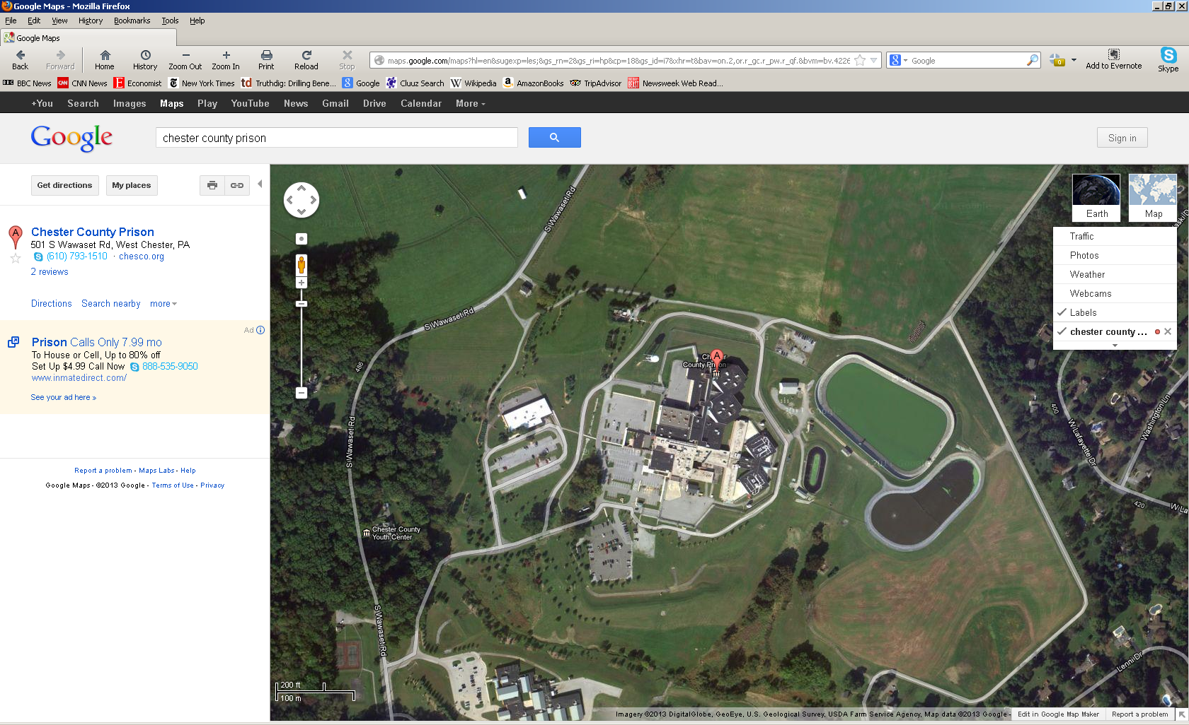
Getting to the Prison
Prison Parking
Prison entrance
Pre-release Ctr.
Guard Gate
Youth Ctr.
Notes:
Note: Only take your identification and car keys. Leave everything else secured in your vehicle.
When going to the Youth Center:
Enter the complex
Make a right hand turn into the entrance for the Youth Center
Park
Ring the bell to enter the building
Someone will ask if they may help you. Simply respond like you are here for the Thresholds class.
When going to the Correctional Center
Enter the complex
Bear to your left and proceed to the Guard Gate
Stop at the Gate and inform the Correctional Officer that you are here on Thresholds business – simply greet the CO and say “Thresholds”
Proceed through the gate and take the first left hand turn towards the Correctional Center
Make the second (or first) right hand turn into the parking lot
Park
Walk up the steps to the building’s entrance
Inform the CO that you are here for Thresholds and provide the student-inmate’s identification information (full name and cell number)
Provide the keys to your vehicle and valid photo identification to the CO
Sign the book
You should receive a key tab and a visitor’s badge
Proceed down the door to your left and down the stairs to meet with your student
When going to the Main Prison
Enter the complex
Bear to your left and proceed to the Guard Gate
Stop at the Gate and inform the Correctional Officer that you are here on Thresholds business – simply greet the CO and say “Thresholds”
Proceed through the gate and follow the road until you come to a stop sign.
Proceed through the stop sign and follow the signs designated for Professional Visitors
Park
Walk up the steps to the building’s entrance
Inform the CO that you are here for Thresholds and provide the student-inmate’s identification information (full name and cell number)
Provide the keys to your vehicle and valid photo identification to the CO
Sign the book
You should receive a key tab, a visitor’s badge, and a slip of paper requesting your student
Walk through the metal detectors
Walk through the door – once buzzed in.
Prepare to be wanded if you set off the metal detector
Proceed down the hallway turning right at the end.
Wait to enter the first cell door.
Enter the door
Wait to enter the second cell door after the first one closes.
Proceed to the CO out in front of the Control Center
Provide the paper to CO
Follow directions – you may be told what station to sit

Slide 73
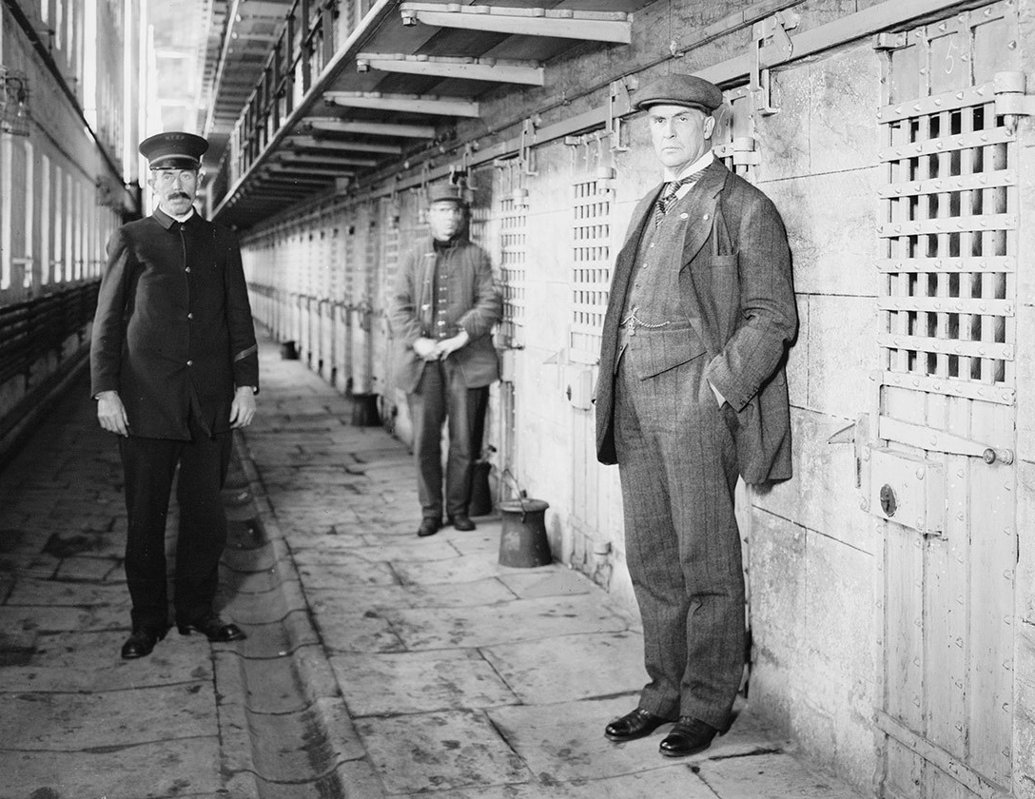

Thresholds – Decision Making
Prison Do’s and Don’ts for Teachers
See section 5.2 Volunteer Training Manual
Read Do’s & Don’ts [next 2 slides]
What stands out to you?
Any questions about being in the Prison?
NOT
Notes:
VTM section 5.2

Slide 74
Thresholds – Decision Making
Resource – Teaching Dos and Don’ts
Your goals are to help the client  avoid reactive behavior,  use the decisional process to take control of his/her life, and hopefully,  develop a more positive self-image.
The following lists are from volunteers who have learned Dos & Don’ts from experiences with clients in the prison.
Do Not
Divulge details of your personal life
Do favors, bring gifts, act as a reference
Attempt religious or political conversations
Repeat what is told to you without permission
Make assumptions/jump to conclusions about clients
Have a hidden agenda. Be a “buddy” to your client
Ask questions that can be answered “yes” or “no”
Be obtuse, short-tempered, or devious
Talk down, over his/her head, or tell client what to do
Embarrass or expose the client
Contact the client after your sessions are completed
Other than a handshake, DO NOT have physical contact with anyone in the prison.
Notes:
VTM section 5.2
Participants read 5.2 in VTM or on handout
Ask – Which 2 “do nots” are most important to you?

Slide 75
Thresholds – Decision Making
Resource – Teaching Dos and Don’ts
Your goals are to help the client  avoid reactive behavior,  use the decisional process to take control of his/her life, and hopefully,  develop a more positive self-image.
The following lists are from volunteers who have learned Dos & Don’ts from experiences with clients in the prison.
Do
Be on time, prepared & dress appropriately.
Have a client face away from traffic
When in doubt, ask
Be positive, patient, accepting, honest, & expect same
Be flexible, adapt the lesson to meet the client’s needs
Ask questions & clarify statements using examples
Be an active listener; hear what the client is really saying
Focus on client language to clarify thought processes
Keep on track; don’t be diverted from teaching the model
Be yourself
You may well learn, grow, and enjoy yourself in the process
Notes:
VTM section 5.2
Participants read 5.2 in VTM or on handout
Ask – Which 2 “dos” are most important to you?

Slide 76
Thresholds – Decision Making
Prison Dress Code and Visitation Advice
Dress
Casual pants
Collared shirts for men is suggested
Conservative casual attire is acceptable
Closed shoes
Visitation Advice
Limited seating – lawyers get preference
Attend first Macro to meet with your client & set time for weekly 1 - 1
Anticipate a 45-60 minute session
Anticipate variation in access process depending upon correction officers on duty
Pay attention to the red light on the walls. If the light is on, no movement is allowed
Be patient.
Messages can’t be left for a client; if session must be changed/communicate via the Macro teacher
Have client face away from command center; less traffic for them to watch
May be their only visitor…
Some love the workbook, some don’t…don’t worry if they don’t you can talk through it
Be careful about writing information down
Go to the first macro and meet your inmate and get comfortable with process
( No shorts, revealing attire, skirts, sweats, ripped clothes, hoodies, loose tops that can conceal things)
Notes:
Rack in the waiting room for jackets.
Explain about red light and movement.
Explain about shift change (3:00-3:30)
If you can’t make an appointment, contact the macro teacher to get the message to the client. The prison will not get messages to your client. Do not call the prison with the intent of getting information to your client.

Slide 77
Agenda
Registration
Introductions/Structured Conversation
Overview of Thresholds
6 Step Overview
Prison Information/Prison Clearance Forms
Micro/Macro Overview
  Distribute Vol. Teacher Guide & Student Manual
Outline/Detail/Demo – 6 Steps Decision Model
Going to Prison/Prison Guidelines
Open Issues
Closing Ritual & Critique of the day
Notes:
Go through all the sheets in their binder…contacts for the thresholds program, dos and donts, dinner,…

Slide 78
Macro
Teachers
1 – 1 Teacher
Thresholds
Roles & Responsibilities
Client /
student
Role: Macro Teacher
Facilitate Decision Making & related communication models & tools & share own experiences
Responsibilities
Present & review models & tools
Describe own challenges & use of models/tools
Share personal Decision Making challenges & results
Ask questions of ‘clients/students’ to stimulate insights
Create a ‘learning’ environment
Follow-up with 1-1 teachers if questions or concerns arise with their client/student
Notes:
VTM Section 4.7

Slide 79
Thresholds
Roles & Responsibilities
Macro
Teachers
1 – 1 Teacher
Client /
student
Role – Student/Client
Learn & develop own decision making capabilities
Responsibilities
Attend Macro
Examine decision making guide/material
Ask questions, share concerns
  @ Macro
  with 1-1 Teacher
Notes:
What will you do if client does not actively participate?

Slide 80
Macro
Teachers
1 – 1 Teacher
Thresholds
Roles & Responsibilities
Client /
student
Role: 1 – 1 Teacher
Responsibilities
Meet with client student weekly or as assigned with Youth Ctr. to reinforce the Thresholds Decision-making model
Provide opportunities for the client/student to ask questions about the Macro’s they’ve attended and material they’ve read in the Guide
Share personal Decision Making challenges & results
Follow-up with Macro teachers if questions or concerns arise with their client/student
Partner with Client/student to understand how to use and apply the Threshold Decision Making model.

Slide 81
Thresholds – Decision Making
One-to-One Preparation and Teaching
Preparation
Review appropriate lesson plan in the Volunteer Teacher’s Manual
Think about client’s behavior, e.g., interest, awareness, effort, from previous session(s)
Read the section of the Guide [Client’s Workbook] you will cover, and answer the questions
Draw up a plan with the points to emphasize, questions, examples, & approx. time
Assemble needed materials: articles, pictures, rituals, contract, paper, pencils, etc.
Dialogue: “What happened this week?” “What did you learn at Macro this week?” “Have you used pieces of the model”?
Examples: anecdotes from your own experience - that the client can relate to.
Questions: clarify the client’s mindset/understanding, e.g.:
“What did you mean by _______?”
“What does that (word, picture, idea) mean to you?”
Materials: Relevant articles, stories, editorials, pictures - to illustrate and reinforce points.
Humor: May be used to “lighten up” a session, if appropriate.
Review: A return to information already discussed, to reinforce important ideas; or sharing a personal example how you do it.
Notes:
VTM-
Prep – section 4.4
Teaching – section 4.2
Lesson plans section 8
Client Guide

Slide 82
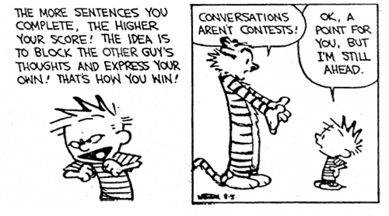
Thresholds – Decision Making
Resource – Listening Skills
Prepare Yourself to Listen
Put other things out of mind.
Stop Talking
Do not interrupt, talk over them or finish their sentences for them.
Remove Distractions
Focus on what is being said.
Put the Client / Student at Ease
Encourage them to continue.
Be Patient
Let them continue at their own pace.
Listen for Ideas – Not Just Words
Get the whole picture
Empathize
Try to understand the other person’s point of view.
Avoid Personal Prejudice
Focus on what is being said and try to ignore styles of delivery.
Listen to the Tone
Volume and tone help you understand what is being said.
Wait and Watch for Non-Verbal Communication
Watch and pick up the additional information being transmitted non-verbally.
Notes:
VTM pg 105 – On Listening Artform poem Section 9.7
Prepare Yourself to Listen
Relax. Focus on the speaker. Put other things out of mind such as what time do I need to leave, is it going to rain –put other thoughts out of mind and concentrate on the messages that are being communicated.
Stop Talking
Do not interrupt, talk over them or finish their sentences for them.
Remove Distractions
Focus on what is being said.
Put the Client / Student at Ease
Encourage them to continue.
Be Patient
Let them continue at their own pace.
Listen for Ideas – Not Just Words
You need to get the whole picture, not just isolated bits and pieces. Maybe one of the most difficult aspects of listening is the ability to link together pieces of information to reveal the ideas of others.
Empathize
Try to understand the other person’s point of view. Look at issues from their perspective. Let go of preconceived ideas. If the client/student says something that you find odd or disagree with then wait and keep an open mind to their view/opinions. Seek clarification to ensure that your understanding is correct.
Avoid Personal Prejudice
Don't let the person’s habits or mannerisms distract you from what they are really saying. Everybody has a different way of speaking - some people are more nervous or shy than others, some have regional accents or make excessive arm movements. Focus on what is being said and try to ignore styles of delivery.
Listen to the Tone
Volume and tone both add to what someone is saying and help you to understand the emphasis of what is being said.
Wait and Watch for Non-Verbal Communication
Gestures, facial expressions, and eye-movements can all be important. Watch and pick up the additional information being transmitted via non-verbal communication. Listening involves observing body language and noticing inconsistencies between verbal and non-verbal messages.
[E.G.- if someone says they are happy with their situation but through gritted teeth or with tears filling their eyes, consider that the verbal and non-verbal messages are in conflict, maybe don't mean what they say]

Slide 83
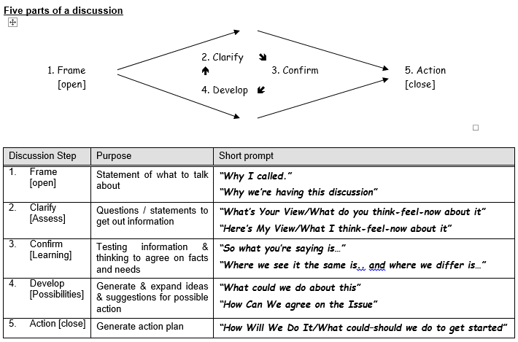

Slide 84
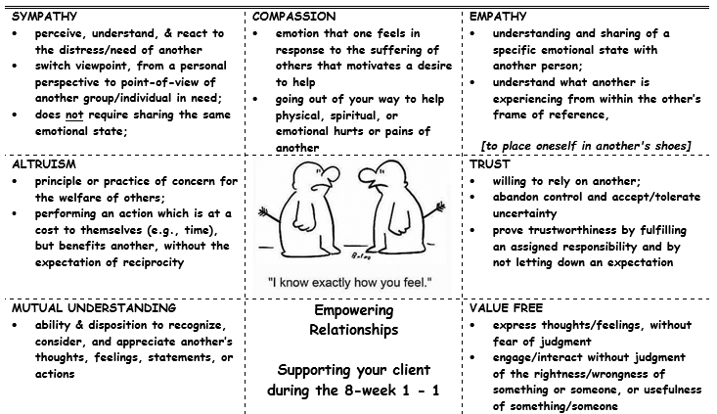

Slide 85
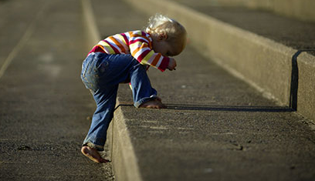
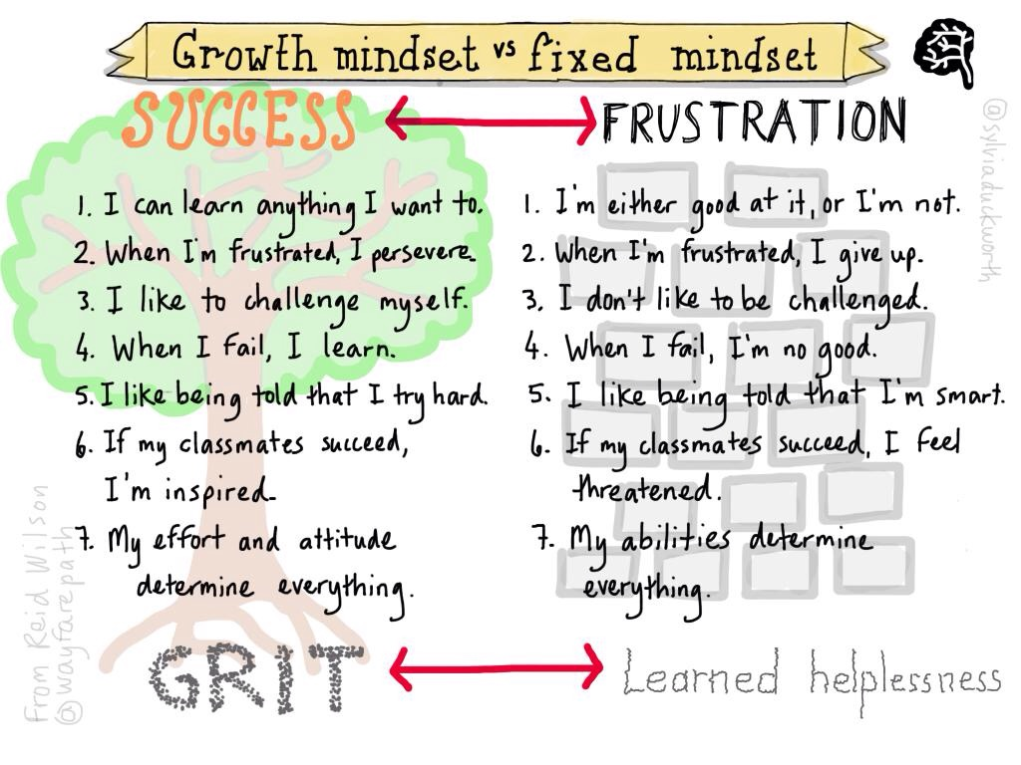

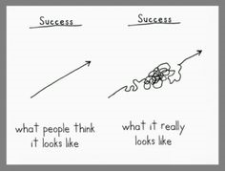


Slide 86
Thresholds
Teacher Self-Images to Avoid
An Island | A person who thinks he/she can function without support from the organization, additional training, or benefit from the experience of fellow teachers.
Know-It-All | A person who has all the answers, often without being asked.
Quick-Fix | A person who expects an overnight success. Clients did not get that way quickly, and do not change easily.
Savior | A person who tries to turn the client around through the strength of his/her beliefs.
Enabler | A person who repeatedly finds ways to support the client in his/her effort to pursue new goals or change behavior. Implicit are unstated identity rewards for the enabler and therefore he/she is reluctant to sever the emotional ties.
Rescuer | A person who attempts to rescue the client from his/her circumstances. With an ever increasing effort being put forth, the client may begin to feel like a pawn in the rescuer’s game.
Notes:
86
VTM section 6.6.12

Slide 87
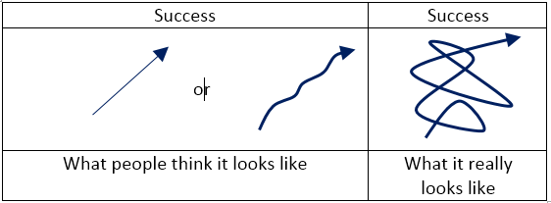
Dealing with getting ‘stuck’ [blocked/hindered/slowed-down]
Pause & consider getting ‘stuck’ is normal – expect it!
  ‘stuff’ usually isn’t easy
Pause & consider how you feel about it [frustration, angry, challenged, motivated]
Pause & consider what is making you fell frustrated / angry
  Is it important?
  Will I be judged on this? if yes-
    Who is the judge [self - internal / others - external]?
    Who said I’m responsible [self - internal / others - external]?
  Do I believe I have the capacity/resources/tools to overcome the obstacle?
Pause & consider where you are ‘stuck’/what is getting you ‘stuck’ – talk to yourself/think about it
  Brainstorm a different ‘way’ that could avoid where or what is getting you ‘stuck’
Encouragement / self-talk to persist through challenges
  Have I tried my hardest or just given it an easy ‘go’?
  Do I really care [see # 3 above]

Slide 88
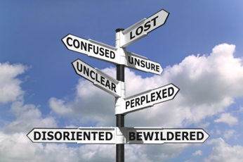


Slide 89
Agenda
Registration
Introductions/Structured Conversation
Overview of Thresholds
6 Step Overview
Prison Information/Prison Clearance Forms
Micro/Macro Overview
  Distribute Vol. Teacher Guide & Student Manual
Outline/Detail/Demo – 6 Steps Decision Model
Going to Prison/Prison Guidelines
Open Issues
Closing Ritual & Critique of the day
Notes:
We end each weekly Macro at the Prison or Correctional Center with an affirmation to build self worth
We want to share that and have you participate withus

Slide 90
Thresholds
Example – Closing Ritual
(stand - - repeat 3 times - - w/increasing volume)
I am the story I tell myself I am
I’ll do the things I tell myself I can
If I can see it, I can do it
If I believe it, there’s nothing to it
I am unique
I am important
I am irreplaceable
I wasn’t born to lose
I was born to choose
I am the story I tell myself I am.
I’ll do the things I tell myself I can
Reacting gives others control over me.
Deciding helps me to feel and be free
90
Notes:
90
Different closing ritual is used at end of each weekly Macro VTM section 9.6
Unique / Important / Irreplaceble is used 1st week & last week multi-week session
Pls stand up and we’ll repeat together, the unique/important/irreplaceable affirmation

Slide 91
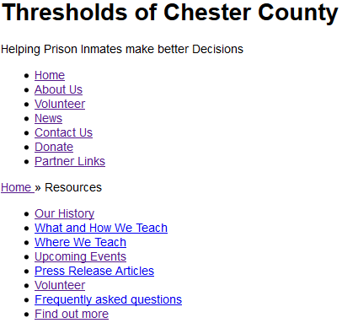

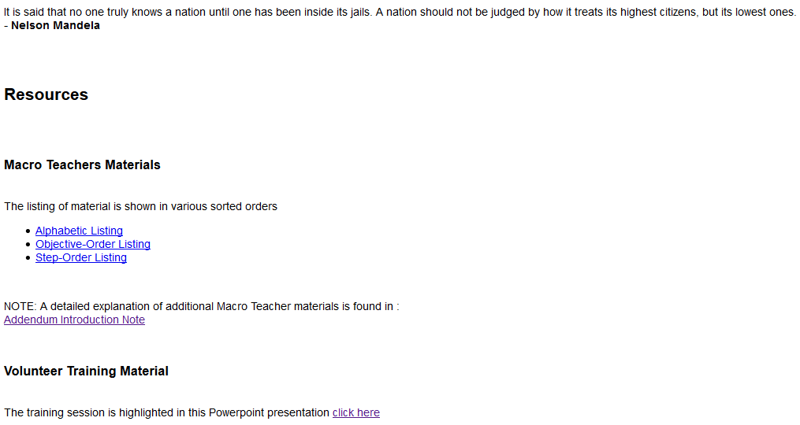
VTW Slides @ Threshold Chester County website
NEW Website:
http://www.thresholdschesco.org/wp/
Old Website:
http://www.thresholdschesco.org/
At home page - click on “Resources”
At Resources page – click to open VTW PowerPoint presentation

Slide 92
Evaluation
Objectives:
Present info needed to be a Thresholds Volunteer Teacher
  Learn 6-step Decision Model
  Learn about Communication tools & resources in the teacher Manual
  Review the Student ‘Guide to Decision Making’
  Understand the process and rules about going to the Prison
Answer questions about the Thresholds org, program content , & the role of a Thresholds volunteer
Ensure Volunteers feel confident in their role
Provide an opportunity to meet & begin networking with other Volunteers
Notes:
4 Objectives for the day—for you to understand the program and tools; which includes prison process and rules…so if you are feeling a bit uneasy about that know that it will be addressed, second to answer any questions you have, 3 to have you leaving here confident in your role and finally to network….great way to meet new people.

Slide 93
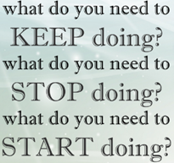
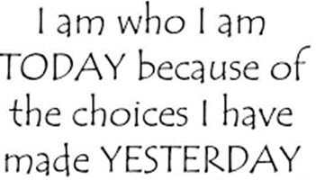
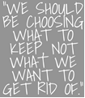
Thank you!!

Slide 94
back-ups / alt’s on following slides

Slide 95
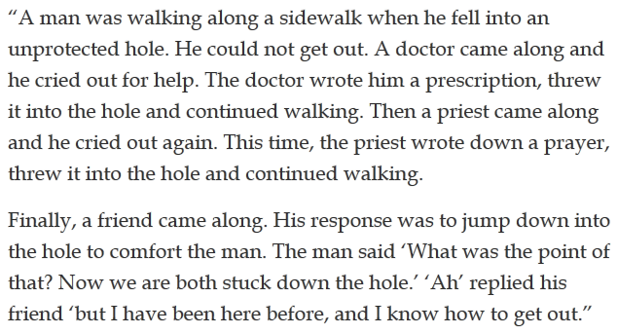




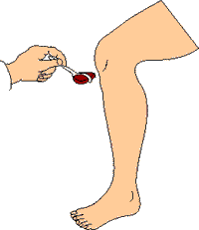
Decision Making
The strategies we use to decide (or not decide)
Impulsiveness — React, pursue the first option and be done.
Compliance — pursue the most pleasing, comfortable & popular option.
Delegation — Not deciding yourself, but pushing/”kicking it off” to others.
Avoidance/Deflection — Either avoiding or ignoring decisions.
Think, Reflect, Balance — Putting thought and effort into choices that are important; consider
the factors involved, weighing & using the information - to reach the best decision for the situation
4
1
2
3

Slide 96





Six Steps To Decision Making

Slide 97







Thresholds Life Skill-Decision Making
2
3
HAPPENING?
1
Define Situation
Set Goal
Develop Possibilities
Evaluate Possibilities
Make Decision
Implement the Decision
6
5
4

Slide 98



Thresholds Life Skill-Decision Making
Thresholds 6 Step Decision Making Model
1. Define the Situation | 2. Set Goal | 3. Develop Possibilities | 4. Evaluate Possibilities | 5. Make Decision | 6. Implement Decision

Slide 99




Define Situation
Roots: (how did I come to be in this situation?)
  Chance
  Assumption
  Reaction
  Decision
External (‘facts’) & Internal (‘feelings’)
Gifts (‘positives’) & Limits (‘constraints’)
Objective Self-awareness
(step back & ask - was my examination thorough / did I let assumptions, biases or filters interfere?)
Examine the characteristics of an event

Slide 100

Set Goal
Where are you coming from?
  Values
  Needs -vs.- Wants
Where are you going?
  Short term; Long term
  Is it?
      Specific
      Achievable
      Measurable
Determine what to achieve in the situation

Slide 101

Develop Possibilities
Techniques:
  Accumulate information
  Brainstorm
  Consider
Blocks:
  Jumping to conclusion
  Again and Again
  Myths
Generate alternatives for achieving my goal in the situation

Slide 102

Evaluate Possibilities
Chart details/info on prospective possibilities
Desirability - positives; its advantages
Risk - negatives; the disadvantages
Others - how others could be affected
Compare the most likely possibilities [use 3 factors)
 | POSSIBILITY |  |  |  | DESIRABILITY |  |  |  | RISK
 |  |  |  | (1-Least // Most- 5) |  |  |  |  | (L, M, H)
1
2
3
Impact-Others |  | Individual |  | IMPACT |  |  |  |  |  | [‘+’ / Neutral / ‘-‘]

Slide 103

Make Decision
Freedom - the control to make it
Capability - the ability to do it
Responsibility - willing to accept responsibility
Commitment - willing to accept consequences
Indecision gives others or circumstances control
    “Not to decide is to decide”
Commit to a choice [cross the ‘threshold’]

Slide 104



Implement the Decision
Action Plan | Act on your decision | Dec’n – WHAT you’ll do [Step 2 & 5] Tactics – How you’ll do it Timeline – tactics in chronological Order / WHEN you’ll do it
Affirmation Plan | Keep yourself on track & motivated | Reminders Symbols & Rituals – meaningful Action pictures – visualize success
Assessment Plan | Look back at how well you used the 6-Step Model | Did action plan accomplish goal? How well did you do - using each step?
Take action -
a decision w/o action
is just a hope…wish

Slide 105



System 1 uses association and metaphor to produce a quick and dirty draft of reality, which System 2 draws on to arrive at explicit beliefs and reasoned choices. System 1 proposes, System 2 disposes. So System 2 would seem to be the boss, right? In principle, yes. But System 2, in addition to being more deliberate and rational, is also lazy. And it tires easily. Too often, instead of slowing things down and analyzing them, System 2 is content to accept the easy but unreliable story about the world that System 1 feeds to it.
Reactive action -vs- Decision Model choice

Slide 106












Overconfidence - All of us, and especially experts, are prone to an exaggerated sense of how well we understand the world.
Planning fallacy - tendency to overestimate benefits and underestimate costs, and hence foolishly to take on risky projects
Decision Biases
Accepting info that confirms initial beliefs and rejecting challenging info

Slide 107

Thresholds – Decision Making
Objective Self –Awareness Tool
The Ladder of Inference describes the thinking process that we go through, usually without realizing it, to get from a fact to a decision or action.
Starting at the bottom of the ladder, there is reality and facts……. From there:
I experience these based on my beliefs and prior experience - and select what interests me
Considering what I’ve selected, I interpret what it means
Then I apply my existing assumptions, sometimes without considering them
Next, I draw conclusions based on the interpreted facts and assumptions
From the conclusions. I develop beliefs
Finally, I take actions that seem "right" because it’s based on what I believe
Notes:
VTM section 3.2

Slide 108
Thresholds – Decision Making
Objective Self –Awareness Tool
I can ‘walk’ down the ladder to improve my ‘objective self awareness’, by acknowledging examining my:
Beliefs & conclusions
Assumptions & added meaning
Observable & selected data
ASK YOURSELF WHAT YOU ARE THINKING AND WHY.
Why have I chosen this course of action? Are there other actions I could have considered?
What beliefs lead to that action? Was it well-founded?
Why did I draw that conclusion? is the conclusion sound?
What am I assuming, and why? Are my assumptions valid?
What data have I chosen to use and why? Have I selected data rigorously?
What are the real facts that I should be using? Are there other facts I should consider?
Notes:
VTM section 3.2

